Slide 1
C2M-App Release
iOS Release
- Puja

Slide 2
Agenda
Launch Checklist.
Publishing Process.
Post Release.
Common App Rejections.
Automatic Deployment.

Slide 3
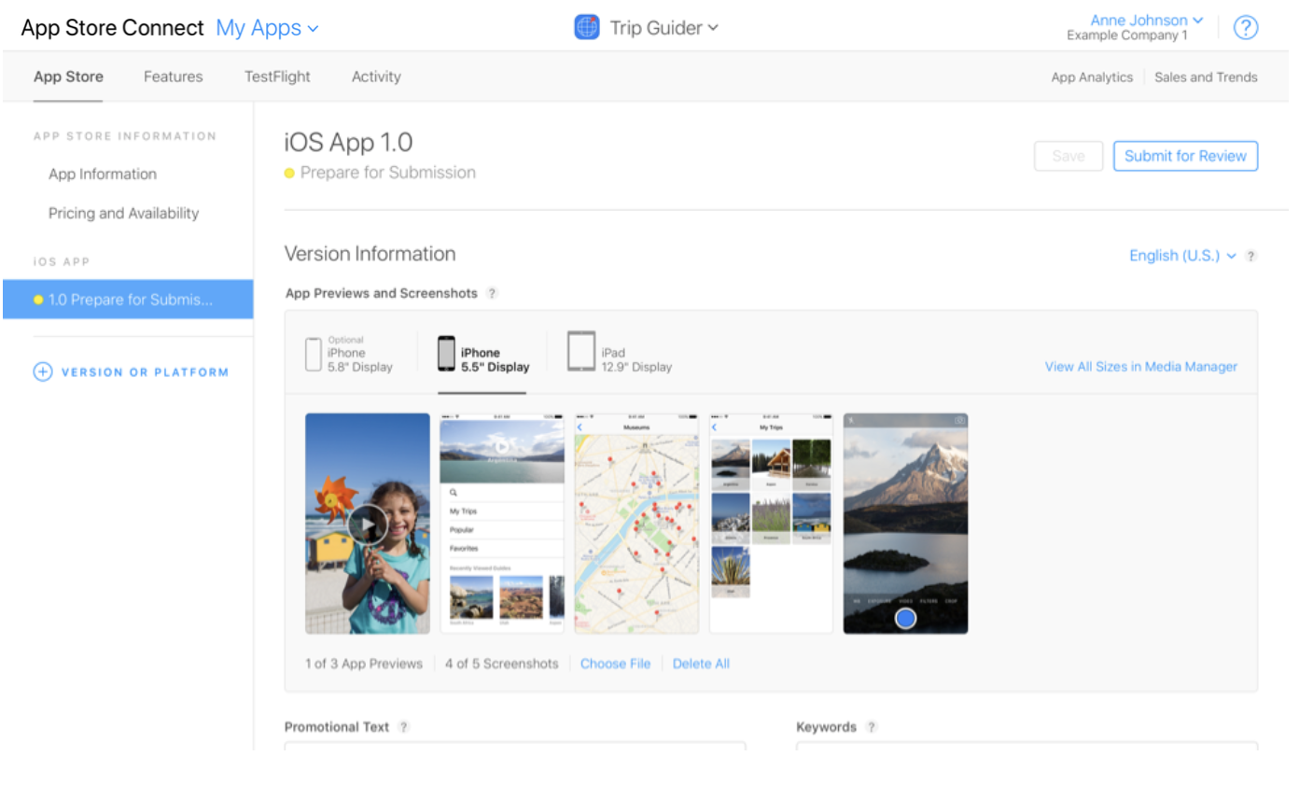
Launch Checklist
App Previews and Screenshots.

Slide 4
Continues ...
App’s Information and Metadata.
App Store Review Guidelines.
Beta Testing.
Managing Your App.
Monitoring Your App’s Usage and Sales.

Slide 5
Prepare For Release
Create a App Id.
Create a certificate Signing Request.
Create an App Store Production Certificate.
Create a Production Provisioning Profile.
Create an App Store Listing.
Create a Release Build.

Slide 6
Distribute an app (TestFlight)
Archive your app
Validate and upload the archive to App Store Connect
In App Store Connect, view build details and metadata to the app version.
Invite internal and external testers.
Users download TestFlight and accept your invitations.

Slide 7
Distribute an app ( Ad Hoc)
Generate ipa file.
Choose your ad-hoc provisioning profile. Make sure it has all device uuids included on the profile.
Send mobile provisioning certificate and ipa file to testers.

Slide 8
Post Release
Make Your Mobile Website Very Informative.
Feature the App in an Official Blog.
Create a Demo Video.
Sincerely Respond To All Your Reviews.
Roll Out New Updates Constantly.
Offer.

Slide 9
Common App Rejections
Crashes and Bugs.
Placeholder Content.
Incomplete Information.
Misleading Users.
Inaccurate Descriptions.

Slide 10
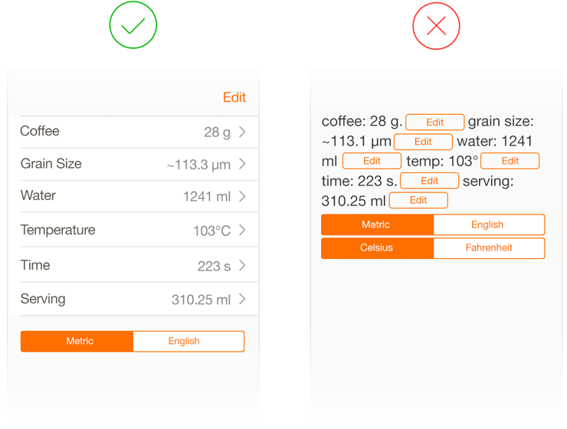
Continues...
Repeated Submission of Similar Apps.
Substandard User Interface.

Slide 11
Automatic Deployment
Fastlane
Generating screenshots, dealing with provisioning profiles.
Creating development and distribution build.
Adding Required meta-data to an app store.
Uploading the app to the app store.

Slide 12
HockeyApp
Distribution of apps
Crash Reporting
Feedback
Managing Your Team and Testers.
User Metrics

Slide 13
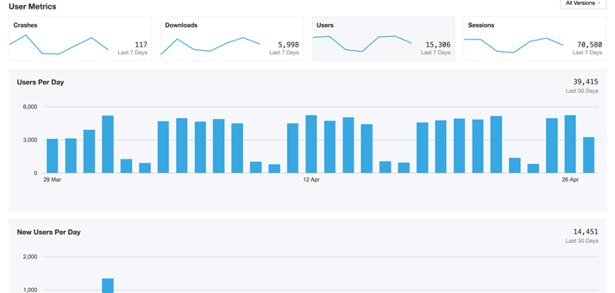
Continues ...

Slide 14
Thank You
P

